Slide 1


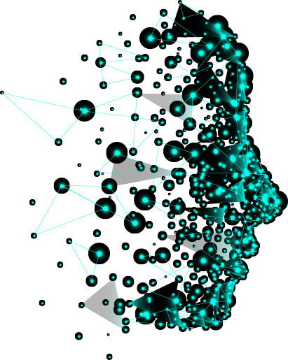







Agentic AI
Transforming Automation & Intelligence

Slide 2
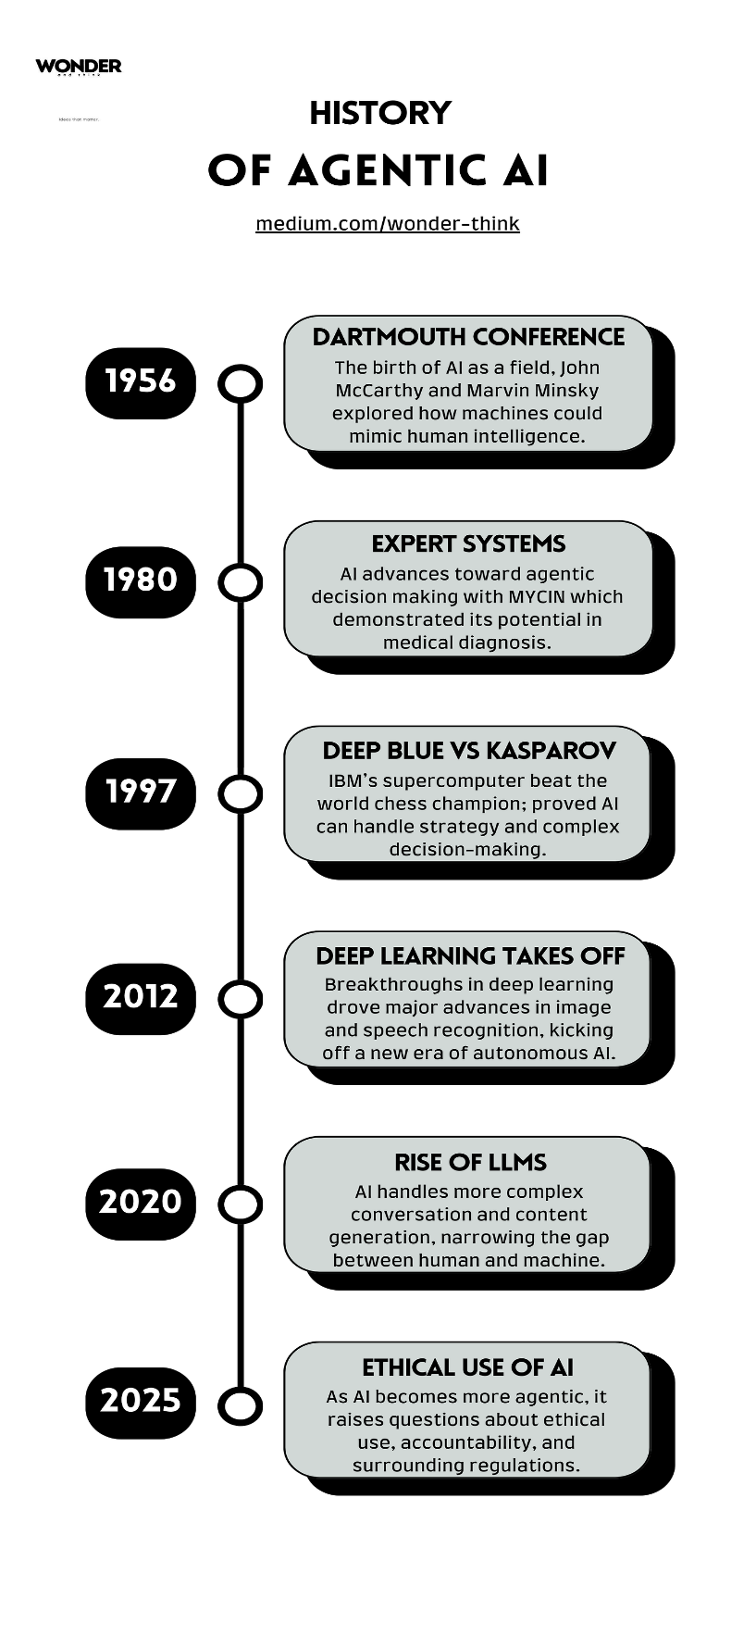
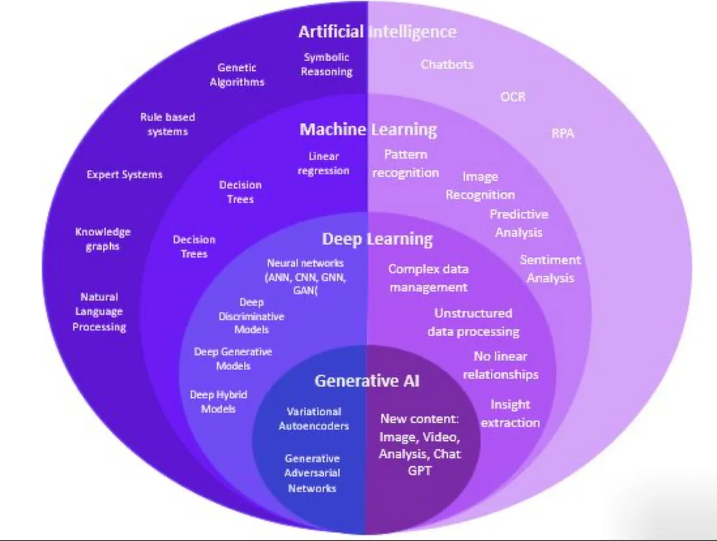
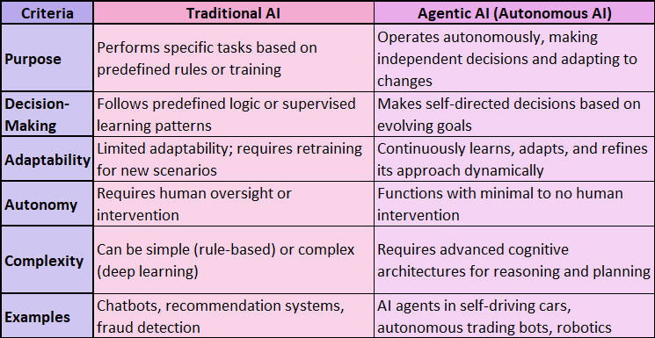
"Agentic" comes from the word agent, which in AI refers to an entity that can observe its environment, make decisions, and act in that environment.
DEFINITION:
Agentic AI refers to artificial intelligence systems that can act autonomously to pursue goals, make decisions, and take actions—often over extended periods—without needing constant human oversight.
Agentic AI systems are designed to have a degree of initiative, planning, and goal-seeking behavior.
These systems can break down high-level goals into sub-tasks, adapt their actions, and interact with tools, humans, or other AIs to achieve their objectives.
Examples:
An AI personal assistant that can plan a trip: book flights, find hotels, schedule meetings, and update plans if delays happen.
AutoGPT: experimental frameworks that allow AI to autonomously create and complete tasks toward a given goal.
ROLE IN AI ECOSYTEM: Agentic AI plays a distinctive and essential role in the broader AI landscape, occupying a middle ground between:
Narrow AI (limited-task systems like chatbots or image classifiers)
Artificial General Intelligence (AGI) (human-level reasoning, still hypothetical)
Core Characteristics of Agentic AI :
Goal-Oriented: Agentic AI focuses on achieving specific objectives by planning and executing multiple steps independently.
Autonomous: It operates without constant human supervision, making decisions on its own.
Adaptive: The system can adjust to new information or changing environments in real time.
Reasoning Capable: It uses logical reasoning to break down tasks and solve problems effectively.
Proactive and Interactive: Agentic AI takes initiative and can interact with tools, systems, or humans to fulfill complex tasks.

Slide 3





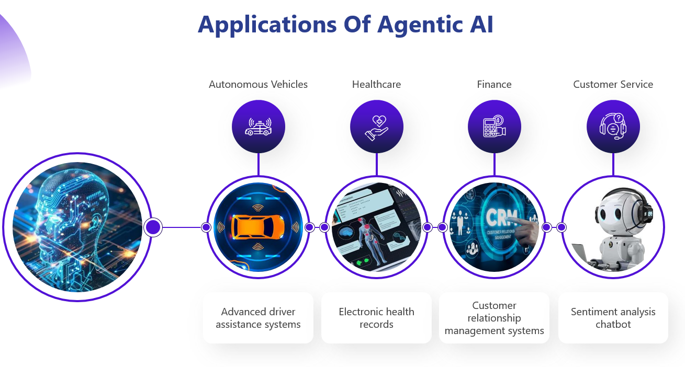
TOOLS AND FRAMEWORKS:
METHODOLOGIES IN AGENTIC AI DEVELOPMENT:
Step 1: Choose an Architectural Approach
Select a design based on task complexity and agent interaction:
Multi-Agent Systems (MAS): Divide tasks among agents for collaboration or competition.
Hierarchical Reinforcement Learning (HRL): Use high-level agents for planning, low-level for execution.
Goal-Oriented Modular Architectures: Use modular components specialized for sub-tasks, enhancing scalability.
Step 2: Select Learning Paradigms
Pick learning methods based on task type:
Supervised Learning: For labeled data and prediction tasks.
Unsupervised Learning: For pattern discovery in unlabeled data.
Reinforcement Learning: For goal-oriented behavior via rewards.
Step 3: Integrate Advanced Methodologies
Equip agents with essential cognitive and operational capabilities:
Reasoning & Planning: To manage complex, dynamic tasks.
Tool Use: To access APIs or external functions.
Memory Mechanisms: For episodic and semantic recall.
Retrieval-Augmented Generation (RAG): For real-time external knowledge retrieval.
Instruction Fine-Tuning: For executing precise, multi-step tasks.
Step 4: Apply Training Techniques
Use robust training environments and strategies:
Simulation-Based Training: Safe, scalable environments for skill acquisition.
Curriculum Learning: Gradually increase task complexity.
Multi-Task Learning: Enable learning across diverse tasks for better generalization.
Step 5: Conduct Evaluation
Evaluate agent performance using these key metrics:
Task Success Rate
Adaptability
Resource Efficiency
Long-Term Goal Achievement
OpenAI Gym – For building and testing reinforcement learning environments.
PyMARL – For creating and testing multi-agent reinforcement learning systems.
Unity ML-Agents – For training agents in 3D game-like simulations.
TensorFlow Agents (TF-Agents) – For developing RL agents using TensorFlow.
TRAINING AND EVALUATION:
Agentic AI training involves methods like simulation-based, curriculum, and multi-task learning to help agents learn safely and progressively. Evaluation focuses on success rate, adaptability, efficiency, and long-term performance to ensure robust intelligent agent behavior.

Slide 4
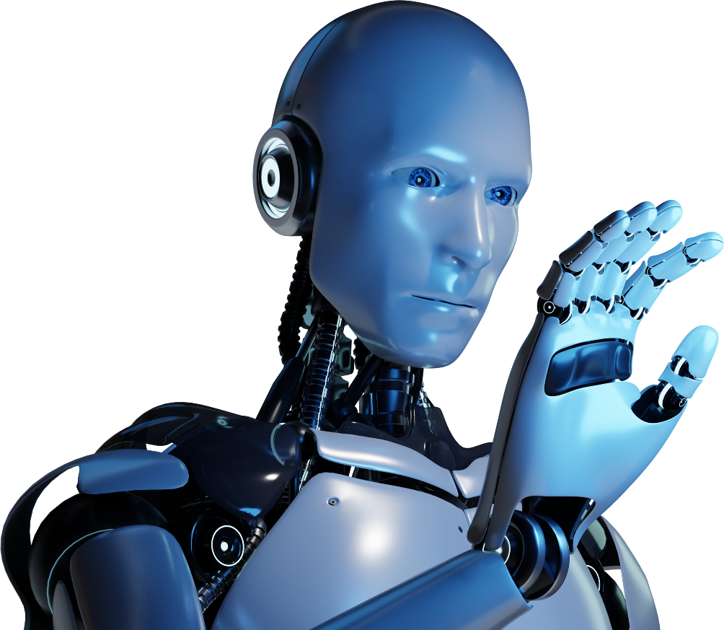



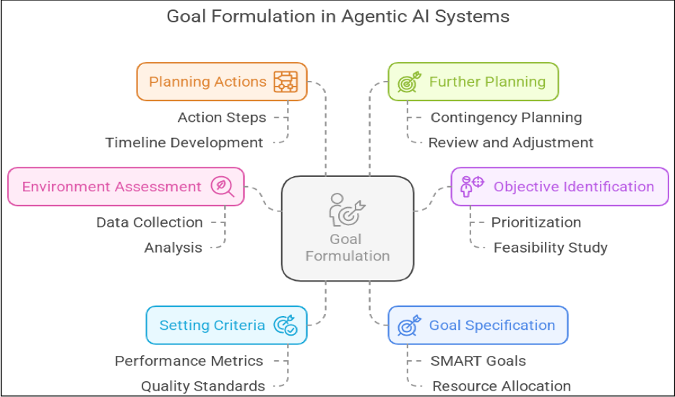


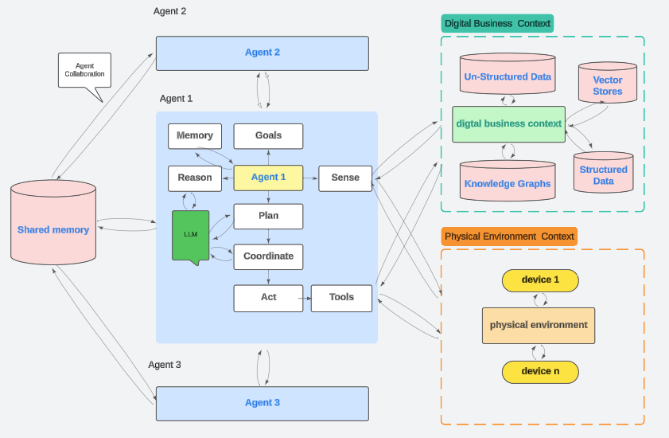

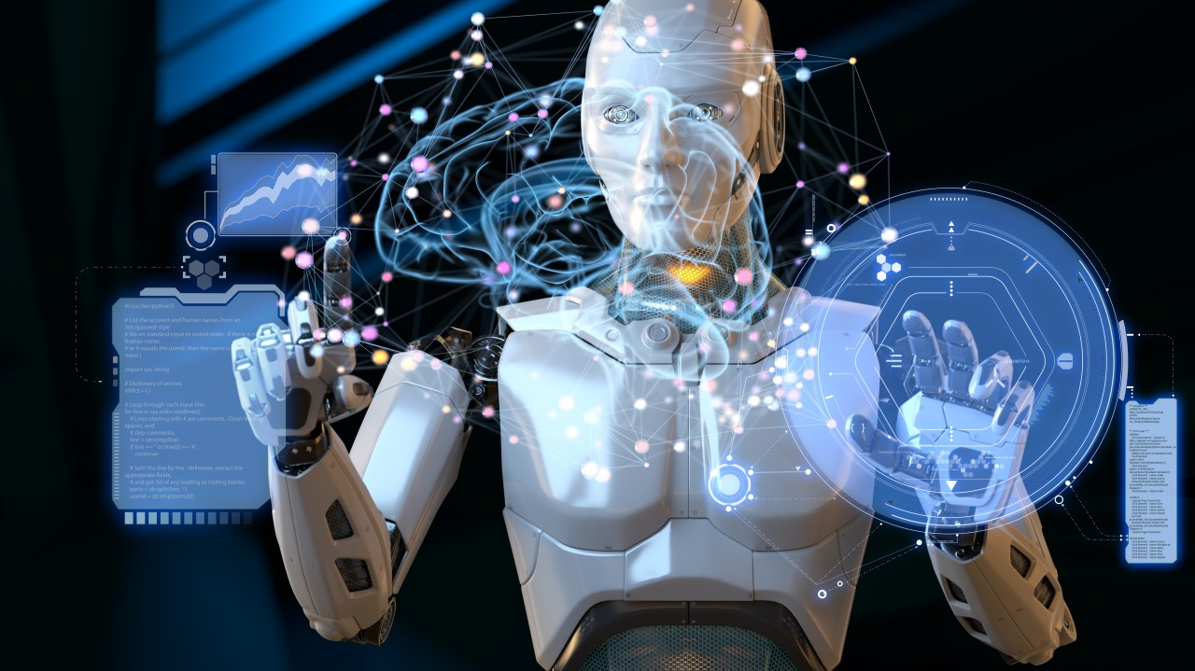

AGENTIC AI COMPARATIVE ANALYSIS:
Metrics: Adaptability, Efficiency, Learning Speed, Scalability, .
Case Studies:
Healthcare: Real-time patient monitoring.
Finance: Adaptive trading during volatility
Benchmarks:
Driving: CARLA, OpenAI Gym
Customer Service: MultiWOZ
Evaluation:
Successes: Timely insights, efficiency gains.
Limitations: Data issues, overfitting, integration challenges.
Lessons: Quality data, feedback loops, hybrid models.
TECHNICAL CHALLENGES AND LIMITATIONS:
Goal Alignment and Complexity
Aligning AI goals with human values is difficult.
Goals may evolve or conflict with ethics (e.g., short-term vs. long-term healthcare decisions).
Environmental and Situational Adaptability
Real-world environments are dynamic and unpredictable.
AI must adapt without full information (e.g., weather in autonomous driving).
Resource Constraints
High computational cost for training (e.g., reinforcement learning).
Needs advanced hardware (GPUs, sensors) and energy-efficient systems.
Scalability
Scaling to smart cities or finance involves many agents and complex tasks.
Challenges in coordination, performance retention, and resource management.
ETHICAL, SOCIAL AND GOVERNANCE IMPLICATIONS:
Accountability – Hard to assign blame for AI’s autonomous actions.
Bias & Fairness – AI can inherit and worsen data biases.
Privacy & Security – Sensitive data use raises privacy and hacking risks.
Regulation – Existing laws are not enough; new AI-specific rules are needed.

Slide 5


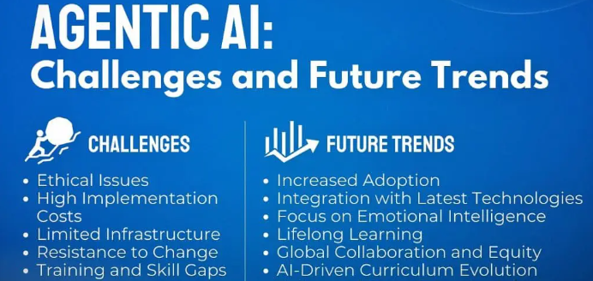
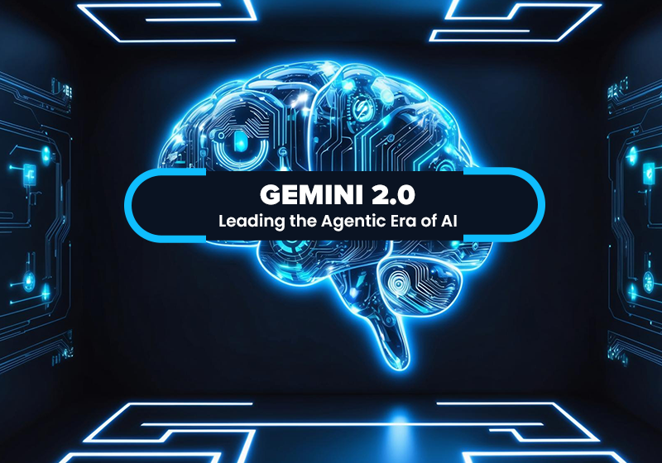
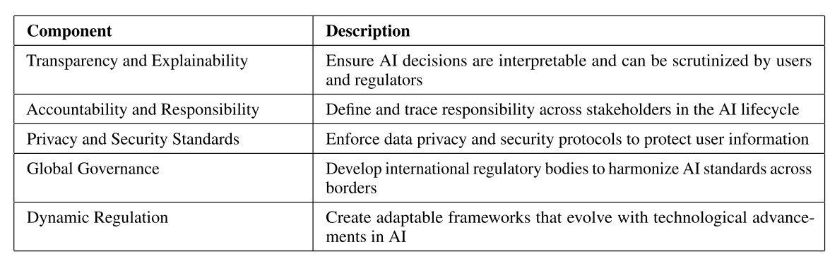
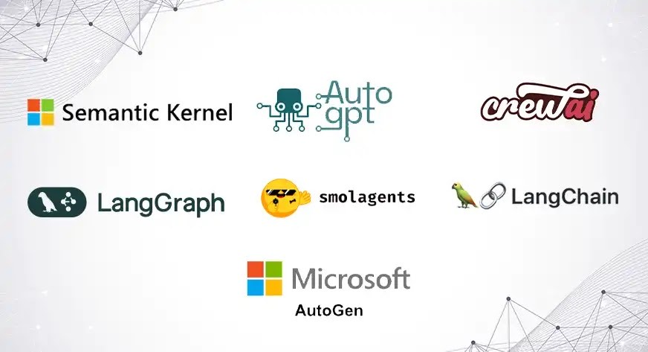
CURRENT FRAMEWORKS FOR SAFE AND ACCOUNTABLE AGENTIC AI:
A. Safety Protocols
Goal Safety – Guides AI to pursue ethical/legal goals.
Fail-safes – Stops AI when risky behavior is detected.
B. Monitoring & Control
Real-time Monitoring – Tracks AI actions for intervention.
HITL & HOTL – Human oversight during or after decisions.
C. Transparency Mechanisms
Explainable AI (XAI) – Makes AI decisions understandable.
Audit Trails – Logs decisions for review.
D. Governance Case Studies
Microsoft – AI principles & ethics committee.
Google – Model Cards & responsible AI use.
ETHICAL FRAMEWORKS AND GLOBAL STANDARDS:

Slide 6



SUMMARY OF KEY FINDINGS:
Agentic AI is a major advancement, defined by autonomy, goal-oriented behavior, and adaptability.
It has impactful applications in sectors like healthcare, finance, and manufacturing
Challenges include scalability, ethical issues, and resource constraints.
Comparative analysis of tools and frameworks shows varying approaches to development.
Open research areas: goal alignment, multi-agent coordination, and regulatory adaptation
FUTURE RESEARCH ROADMAP IN AGENTIC AI:
Future Agentic AI research should ensure objectives align with human values (via IRL methods), scale through decentralized and federated architectures, and improve adaptability with meta- and transfer-learning. It must also prioritize energy-efficient hardware and algorithms, establish robust ethical and governance standards, and develop real-time learning systems that adapt on the fly without interrupting operations.
CONCLUSION OF AGENTIC AI:
Agentic AI represents a significant leap in artificial intelligence, offering autonomous, goal-driven systems capable of complex decision-making and adaptation across diverse environments. While it holds great promise in transforming industries and enhancing human-AI collaboration, its success depends on addressing key challenges such as ethical alignment, scalability, and governance. Moving forward, responsible development with a strong focus on transparency, safety, and societal impact will be crucial to fully realizing the potential of Agentic AI.
Challenges
Ethical Concerns
Regulatory & Compliance Issues
REFERENCES:
W. Cai, J. Wang, P. Jiang, L. Cao, G. Mi, and Q. Zhou, ‘‘Application of sensing techniques and artificial intelligence-based methods to laser welding real-time monitoring: A critical review of recent literature,’’ J. Manuf. Syst., vol. 57, pp. 1–18, Oct. 2020.
S. Saponara, A. Elhanashi, and A. Gagliardi, ‘‘Implementing a real-time, AI-based, people detection and social distancing measuring system for covid-19,’’ J. Real-Time Image Process., vol. 18, no. 6, pp. 1937–1947, Dec. 2021.
Mosqueira-Rey, E. Hernández-Pereira, D. Alonso-Ríos, J. Bobes-Bascarán, and Á. Fernández-Leal, ‘‘Human-in-the-loop machine learning: A state of the art,’’ Artif. Intell. Rev., vol. 56, no. 4, pp. 3005–3054, Apr. 2023.
.
Accountability & Transparency

Slide 7


